Slide 1
Chapter 2 Configuration Space
Chapter 3 Rigid-Body Motions
Chapter 4 Forward Kinematics
Chapter 5 Velocity Kinematics and Statics
Chapter 6 Inverse Kinematics
Chapter 7 Kinematics of Closed Chains
Chapter 8 Dynamics of Open Chains
Chapter 9 Trajectory Generation
Chapter 10 Motion Planning
Chapter 11 Robot Control
Chapter 12 Grasping and Manipulation
Chapter 13 Wheeled Mobile Robots
13.1 Types of Wheeled Mobile Robots
13.2 Omnidirectional Wheeled Mobile Robots

Slide 2
Important concepts, symbols, and equations
Types of wheels
Kinematic wheeled
mobile robots
(no skidding, slipping)
conventional omniwheel mecanum wheel
differential drive car-like omnidirectional

Slide 3
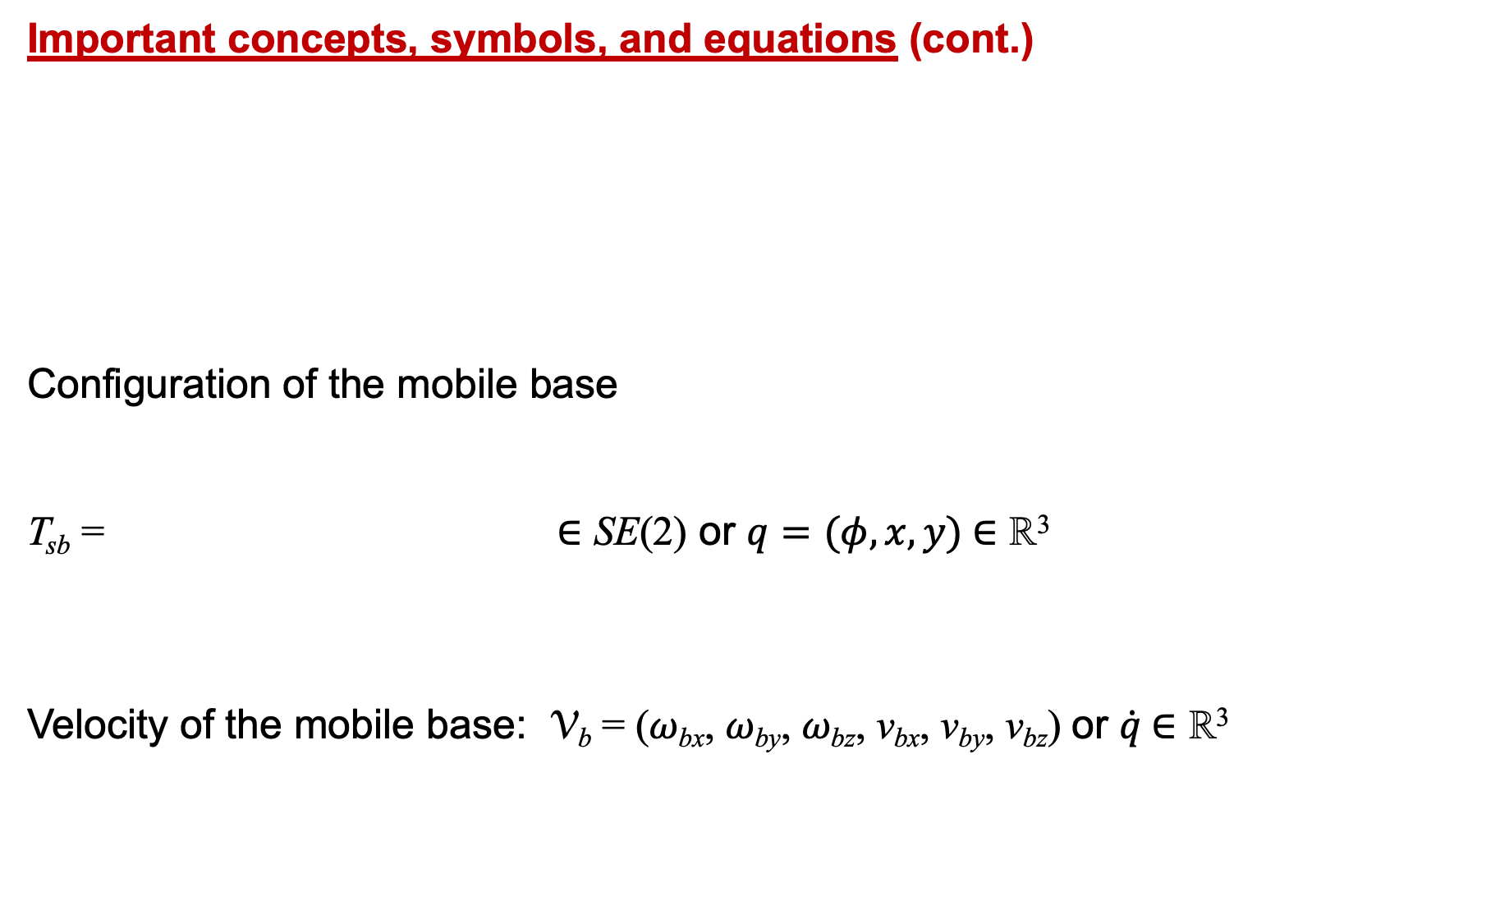

Important concepts, symbols, and equations (cont.)
Configuration of the mobile base
T_{sb} = ∈ SE(2) or $q=(φ,x,y)$ $\text{∈ }\text{ℝ}$³
Velocity of the mobile base: V_{b} = (𝜔_{bx}, 𝜔_{by}, 𝜔_{bz}, v_{bx}, v_{by}, v_{bz}) or $\dot{q} \text{∈} \text{ℝ}$³

Slide 4
Important concepts, symbols, and equations (cont.)
Examples of
omnidirectional
wheeled mobile
robots

Slide 5
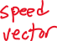
Important concepts, symbols, and equations (cont.)
u_{i} = h_{i}(0)V_{b}

Slide 6
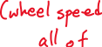
Important concepts, symbols, and equations (cont.)
Why are at least three
wheels required for
omnidirectional motion?
spin in place
right
up

Slide 7
Important concepts, symbols, and equations (cont.)
Wheel velocities are 4d.
Chassis twist is 3d.
Implications?
spin in place
forward
sideways

Slide 8

Important concepts, symbols, and equations (cont.)
Wheel speeds in terms of $\dot{q}$:

Slide 9

Important concepts, symbols, and equations (cont.)
Feedforward + PI feedback stabilization of a planned trajectory:
Stability and steady-state error
for different control laws and
desired trajectories?

Slide 10
Important concepts, symbols, and equations (cont.)
Given wheel velocity limits, the chassis’ feasible twists lie inside a 2m-sided convex polyhedron:
}
define two parallel bounding planes in twist space

Slide 11
Important concepts, symbols, and equations (cont.)

Slide 12
Important concepts, symbols, and equations (cont.)
What does it mean
if the convex
polyhedron is
unbounded?

Slide 13


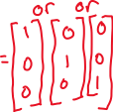

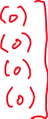


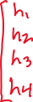
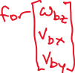


2L
The centers of the omniwheels of a mobile
robot are at the corners of a square a
distance 2L from each other. The radius of
the wheels is r, and the forward driving
direction for each wheel is to the right.
What is H(0)?
wheel 4
wheel 1
wheel 3
wheel 2

